Slide 1
Week 4
Statistical Philosophy

Slide 2
One more ggplot2 trick
Library(gridExtra)
#you have two plots g3, and g1
#just look at them together
grid.arrange(g3, g1, nrow=2)
#make a “grob” to combine them
g <- arrangeGrob(g3, g1, nrow=2) #generates
ggsave(file=”~figs/FIG1.pdf",g, width=19,height=12,units="in",limitsize=F,useDingbats=FALSE) #saves g
Also see package ‘cowplot’

Slide 3
Discussion on Thursday
Thursday we will have a class discussion
Please be prepared to speak at least once
Please read articles 1-4. They should not be too hard to get through. Think about your own statistical philosophy and be prepared to talk about what statistical inference means to you.
Consider looking through articles 5 -8. Different articles will speak to different people.

Slide 4
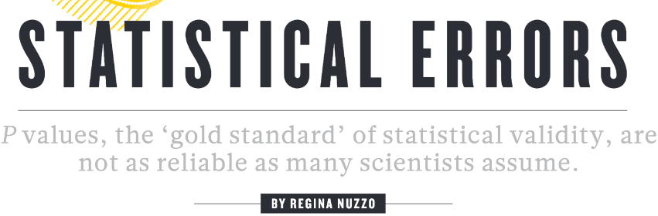
Leads for each paper (+1 on week 3 assignment)
Paper 1
c

Slide 5
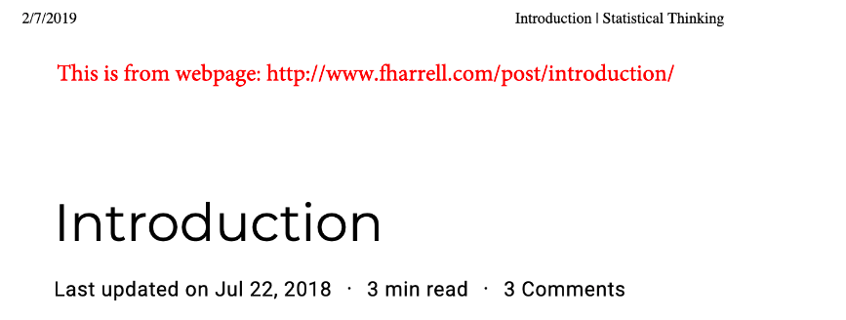
Leads for each paper (+1 on week 3 assignment)
Paper 2

Slide 6
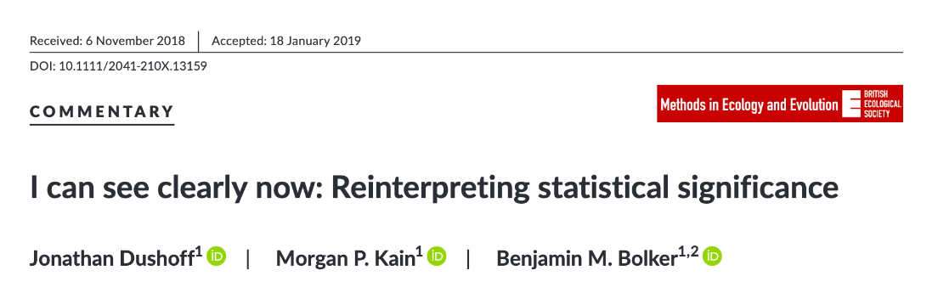
Leads for each paper (+1 on week 3 assignment)
Paper 3

Slide 7
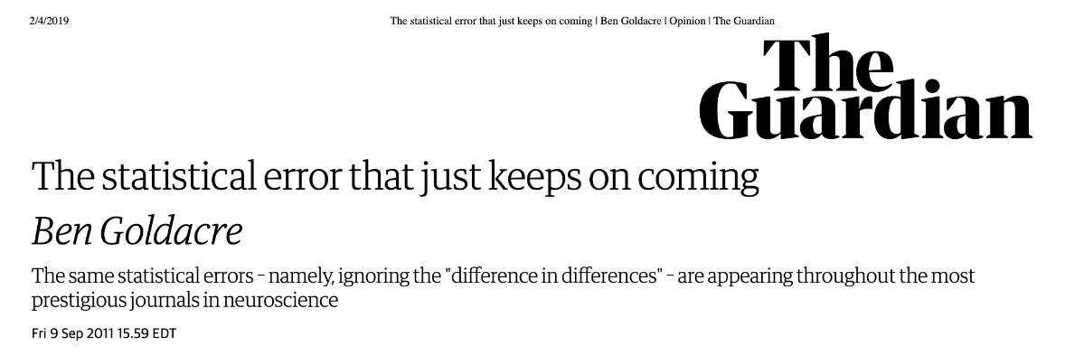
Leads for each paper (+1 on week 3 assignment)
Paper 4

Slide 8
Goals
Articulate some statistical philosophies and describe similarities and differences
Understand P-values and their limitations
Understand effect sizes and their importance

Slide 9
But you said this class was about doing things!

Slide 10
Discussion
Formulate a hypothesis/question about your data, and discuss how you would test it statistically/computationally/mathematically.

Slide 11
What is a model?
Different types of models:
A mathematical/computational model is an abstract model that uses mathematical language to describe the behavior of a system
Techniques vary, but often formulated using ODEs or PDEs
Examples: predator-prey models, species competition models, SIR models
Resources: A Biologists Guide to Mathematical Modeling – Otto & Day; Math-Bio grad class in Math Dept (MAT 5516, alternately taught by Childs, Saucedo, or Ciupe)
A statistical model attempts to describe relationship between observed quantities and independent variables
Techniques include linear models, generalized linear models, GAMMs, PCAs
Developing mathematical models is different from statistical analyses of data

Slide 12
Why build a mathematical model?
Goals vary, but often focus on:
Understanding nature and how something changes over time
Making predictions about something that is going to happen in the future
Example: How many COVID-cases will occur on May 15 in Blacksburg?
This is a difficult problem to solve with statistics
Input: cases in previous time point, vaccine distribution, vaccine effectiveness, strain replacement and transmissibility, number of susceptible individuals remaining
A mathematical model is a better tool to solve this problem

Slide 13
Merging mathematical models with statistics
Mathematical models can be fully built and simulated
Determining the accuracy of a mathematical model usually requires statistics!
“Model fitting” or “Model inference” is the term used for this blend
Can be done in either Bayesian or Frequentist framework
Guess a value for a parameter
Simulate model based on guessed values
Get an outcome (maybe # of individuals infected)
Compare simulated outcome to real outcome, calculate error
Based on error, make a new guess
Most of the sophisticated fitting algorithms are based on how you choose a guess and how you evaluate the error
Bayesian – algorithm: Gibbs sampling – function “jags” in R2jags
Frequentist – algorithm: Nelder-Mead - function ”optim” in R
Notes:
http://biometry.github.io/APES//LectureNotes/StatsCafe/Linear_models_jags.html; https://theoreticalecology.wordpress.com/2010/09/17/metropolis-hastings-mcmc-in-r/

Slide 14
How to use statistics
We use statistics to confirm effects, estimate parameters, and predict outcomes
It usually rains when I’m in Cape Town, but mostly on Sunday.
Confirmation: In Cape Town, it rains more on Sundays than other days
Estimation: In Cape Town, the odds of rain on Sunday are 1.6–2.2 times higher than on other days
Prediction: I am confident that it will rain at least one Sunday the next time I travel to Cape Town for 4 weeks

Slide 15
Estimation
We use P values to say how sure we are that we have seen some effect
We use statistics (like confidence intervals, model coefficients/parameters) to describe the magnitude of that effect
WE DO NOT USE P-VALUES ALONE

Slide 16
P-values
What does it mean if I find a significant P-value for some effect?
It means that the effect is unlikely to be due to chance alone (but the converse isn’t true)

Slide 17
What can or can’t we say with P-values?

Slide 18
Vitamin A example
We want to know if vitamin A supplements improve the health of village children
How will we know height differences are due to our treatment?

Slide 19
Vitamin A example
We want to know if vitamin A supplements improve the health of village children
How will we know height differences are due to our treatment?
We want the two groups to start from the same point – independent randomization of each individual
We may measure changes in height
Or control for other factors

Slide 20
What do we hope to learn?
Is vitamin A good for these children?
How sure are we?
How good do we think it is?
How sure are we about that?

Slide 21
What does it mean to find a significant P-value for some effect in this experiment?
It means that the difference between the treatments is unlikely to be due to chance
But, it doesn’t provide much insight into our other questions (e.g. how good?

Slide 22
Confidence Intervals
What do these results mean?
Which are significantly different from 0?

Slide 23
Confidence intervals and P values
A high P value (e.g. P = 0.62) means we can’t see the sign of the effect clearly
A low P value (e.g. P = 0.00001) means we can see the effect clearly

Slide 24
The meaning of P-values
A P-value measures whether we are seeing something clearly
It’s usually the sign (+/-) of some quantity, but it doesn’t need to be

Slide 25
Types of Statistical Error in Hypothesis Testing
Type I (False positive:) in the hypothetical case that the effect is exactly zero, what is the probability of falsely finding an effect
Should be less than or equal to my P-value
Type II (False negative:) what is the probability of failing to find an effect that is there?
Useful, but can only be asked for a specific hypothetical effect size
These types of error are useful to analyze power and validity of a statistical design
You should do these analyses before you collect data, not after

Slide 26
Improved (?) ways of thinking about error
Sign error: if I think an effect is positive, when it’s really negative (or vice versa)
Magnitude error: if I think an effect is small, when it’s really large (or vice versa)

Slide 27
Low P-values (e.g. P < 0.05)
If I have a low P-value, then I can see something clearly
This is great, but it is usually better to focus on what I see than the P-value
VERY IMPORTANT: directionality
Do not write: These things are significantly different. (Who cares? Everything is different)
Write: X is significantly higher than y (magnitude, error, p-value)

Slide 28
High P-values (e.g. greater than 0.1)
High p-values denote something that you can not see clearly
It may be because the effect small (possibly).
High p-values should not be used to be advance your conclusion.

Slide 29
What causes high P-values?
Small differences
Less data
More noise
An inappropriate model
A lower P-value means that your evidence for difference is better, but a higher P-value means that your evidence for similarity is better OR worse

Slide 30
Why is weather not causing deaths?
P values sig. diff. from 0

Slide 31
Confidence intervals tell us much more
The effect of weather COULD be greater than flu.

Slide 32
Logical tendencies
It is not technically correct to say flu is significant, but weather isn’t, therefore flu is a more important killer of people than weather
You should use a statistic to examine this directly

Slide 33
Small effects
We can’t build statistical confidence that something is small by failing to see it clearly
We must instead see clearly that it is small
This means we need a standard for what we mean by small

Slide 34
Statistical Paradigms
Frequentist
Bayesians

Slide 35
Frequentist paradigm
Make a null model
Test whether the effect you see could be due to chance

Slide 36
Height measurements: Does group A have significantly higher heights than group B?
Test whether the effect you see or a larger effect could be due to chance
This probability is the P-value
Mean diff is 3.676 cm

Slide 37
Height measurements
Scramble 1000 times, and each time calculate a mean

Slide 38
Plot distribution of mean differences (null dist)
3.67 cm was less than 2 observations out of 1000
2/1000 = 0.002
P = 0.002

Slide 39
Breaking down the frequentists
Frequentist
P-value -ists
Information theoretians
Maximum likelihood-ists
Bayesians

Slide 40
P-value-ists
Characterized by an undying love for P-values
An unrealistic focus on null hypotheses: there is no significant difference between groups
These are often strawmen - they don’t make sense in biology

Slide 41
Maximum likelihood-ists
More of a focus on estimating the effect size, it’s precision, and it’s sign
Finds a set of parameters for a model that makes the observed data most likely to have occurred
Computes the probability of the observed outcome (likelihood) given a choice of parameters, and find the parameters that make the likelihood as big as possible (i.e. maximizing likelihood)

Slide 42
Information theoreticians
E.g. Burnham and Anderson, AIC
Construct multiple hypotheses rather than a simple null vs alternative
Include a global model including most important and biologically relevant parameters, as well as set of a priori hypothesis
AIC is then computed for all the models
Can calculate likelihood of the model, given the data to get weights which can be interpreted as probability that model i is the best model in the set
Not trying to model the data, but model the information in the data

Slide 43
Bayesians
Make a complete model world
Use conditional probability to calculate the probability you want
Assumes observed data are true while parameter values have probability distributions

Slide 44
Bayesian Inference
We want to go from a statistical model of how our data are generated, to a probability model of parameter values
Requires prior distributions describing the assumed likelihood of parameters before these observations are made
Use Bayes theorem to calculate posterior distribution – likelihood after taking data into account

Slide 45
What are my hypothesized parameter values?
This is the part that makes frequentists sweaty
Bayesians will often say they are choosing “uniform priors”
You still need to specify some parameter space by which this parameter exists

Slide 46
Vitamin A study
A frequentist can do a clear analysis right away
A Bayesian needs a ton of assumptions – will try to make “uninformative” assumptions

Slide 47
Your philosophy
Statistics are not a magic machine that gives you the right answer
If you are to be a serious scientist in a noisy world, you should have your own philosophy of statistics
(Mine is do it a few different ways, if you get the same answer, it’s probably right)
Be pragmatic: your goal is to do science, not get caught by theoretical considerations
Be honest: it’s harder than it sounds.

Slide 48
Honesty
You can always keep analyzing until you find a significant result, but be careful
Analyzing the magnitude of an effect is a way to distance from this approach

Slide 49
Good practice
Keep a journal of analyses you have done (or better yet, a README)
Start thinking about analyses before you even look at your data

